Slide 1
CS 4530: Fundamentals of Software Engineering Module 17: Using AI Agents
Adeel Bhutta, Joydeep Mitra, and Mitch Wand
Khoury College of Computer Sciences
with material from Jon Bell
© 2025 Released under the CC BY-SA license

Slide 2
Learning Goals for this Lesson
By the end of this lesson, you should be able to
Explain what an AI Coding Agent is and is not
Describe when using an AI agent is or is not appropriate
Explain a good pattern for using an AI coding agent
Understand the basics of good prompting
Know how to supervise an AI coding agent at work
Know how to avoid de-skilling
Notes:
<read slide>

Slide 3
Outline
What is an LLM?
What can an LLM do for you? What can't it do?
A Pattern for using an LLM
Organizing your prompts
When to use an AI/When not to use an AI
Long-term implications of AI in SE

Slide 4
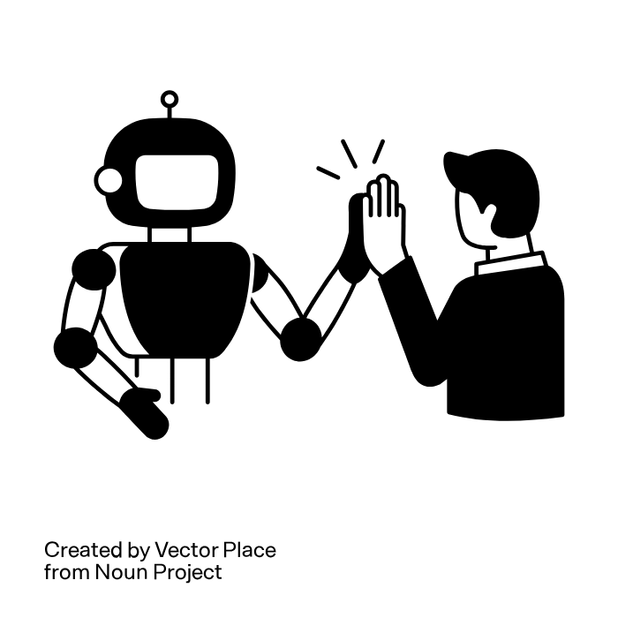
Our Slogans (1)
AI amplifies human capabilities, not replaces them
https://thenounproject.com/browse/icons/term/ai-collaboration (CC BY 3.0)

Slide 5

Our Slogans (2)
Learning Comes Only Through Struggle
https://www.dreamstime.com/illustration/inner-struggle.html

Slide 6
Disclaimer
I do not claim to be an expert on this subject
These materials are based only on my own limited experience
Much credit to Prof. Jon Bell and the CS 3100 team, on which this lecture is based.

Slide 7
What is a Large Language Model (LLM?)
Basically, it is an overgrown autocomplete.
Given a large database of texts and an initial segment of your input, it answers the question:
What is the most likely way in which this input would continue?
Need graphic here

Slide 8
Is there more?
Yes: the "input" it is trying to complete can include
all the files in your project.
the dependencies in your codebase
the structure of your codebase (matching against the codebases it knows about)
Yes: it can run commands, look at the output, and suggest fixes
No: it's all just a question of what's the "input" it's trying to complete, and a scary big database it's matching against

Slide 9
What can an AI do for you?
Analyze your codebase
Write code
Run tests and look at the output
Suggest fixes
AI in the loop
Need screenshot here
Notes:
Having "AI in the loop" is far more efficient than having to cut-and-paste all the time.

Slide 10
Example
You ask the agent to “implement a method to calculate the average of a list”
The agent generates code, but it has a type mismatch error
The IDE’s linter immediately flags the error
The agent sees the error message, understands the issue, and regenerates corrected code
This cycle continues until the code compiles successfully

Slide 11
Examples of AI Coding Agents
Github Copilot
Cursor
Claude Code
Windsurf (Codium)
…list grows daily…

Slide 12
Strengths of AI Coding Agents
Natural Language Understanding: Can translate requirements and comments into working code
Syntax Knowledge: Have extensive knowledge of language syntax, standard libraries, and common frameworks
Contextual Awareness: Understand your current code context and can generate code that fits existing patterns
Rapid Prototyping: Enable quick generation of boilerplate code, tests, and common implementations
Pattern Recognition: Excel at recognizing and reproducing common coding patterns from their training data or applying patterns from one part of the codebase to another
Cross-Domain Transfer: Can apply patterns from one domain or language to another

Slide 13
Limitations
Context Window Constraints: Can only process a limited amount of information at once (typically 4,000-128,000 tokens), which may not include your entire codebase
Training Data Cutoff: May not know about recent libraries, API changes, or language features released after their training cutoff
Limited Project-Specific Context: Don’t automatically know your team’s conventions, architectural decisions, or business rules unless explicitly provided
Hallucination Risk: May generate plausible-looking code that doesn’t actually work or uses non-existent APIs
Lack of Deep Understanding: Don’t truly “understand” your codebase’s architecture or design rationale—they work with surface-level patterns

Slide 14
A Pattern for using AI programming agents
Identify: Recognize what information AI needs (requires domain knowledge)
Engage: Craft effective prompts with appropriate context and stating the desired outcomes
Evaluate: Critical assessment of AI outputs against expected results utilizing domain knowledge. Compare output against expected end results and other success criteria.
Calibrate: Steer AI toward desired outcomes through feedback
Tweak: Refine AI-generated artifacts based on standards
Finalize: Document decisions and rationale

Slide 15
Identify: what information does the AI need?
What are the domain concepts?
What level of detail is needed for the initial domain model
What requirements information should be captured (user stories, functional requirements, non-functional requirements)
What design artifacts would be useful for us to generate and maintain
This is typically transmitted as a set of .md files ("the prompt")

Slide 16
Organizing your prompts
The prompt is the way you give the AI instructions at the start of a project
Typically a set of .md files
In a place that your particular AI recognizes.
Probably a good idea to organize your prompts around your conditions of satisfaction

Slide 17
Engage: Design Artifacts to maintain
PLAN.md: High-level project plan, requirements, user stories, and implementation phases
DESIGN.md or MODEL.md: Data models, architecture decisions, design patterns, and alternatives considered
REQUIREMENTS.md: Detailed functional and non-functional requirements, constraints, and acceptance criteria
DECISIONS.md: Records of key architectural and design decisions, including rationale
Notes:
All these are part of the initial prompt. Need to keep these in version control so they evolve with the codebase.

Slide 18
Here's a prompt I actually used (1)
# Project Scope
This is a very simple project to illustrate a frontend-backend web architecture
## Project Components
Typescript
node.js
vitest
eslint
stryker
vite

Slide 19
My Prompt (2)
## Coding Standards
- Use TypeScript with strict mode
- Prefer functional programming patterns
- Always include error handling
- Write self-documenting code with clear variable names
- Never delete tests
- Avoid using "any" type unless absolutely necessary
- Avoid imperative programming constructs like loops and mutable state
- Avoid using "unknown" type; prefer specific types or generics

Slide 20
My Prompt (3)
## Repository Structure
- `src/` for source code
- `additionService.ts` for business logic
- `additionController.ts` for handling requests
- `*.test.ts` for tests
- `scratchpad.ts` for experimental code
- `express.ts` for express app setup
- - `src/server.ts` to start the application
- `package.json` for dependencies and scripts
## Response Format
- For complex requests, guide me step-by-step
- Provide complete, working code
- Include brief explanations for complex logic
- Suggest optimizations when relevant

Slide 21
My Prompt (4)
## Development
- Develop each layer independently
- Write tests for all new functionality
- Use `npm run lint` to check code style
- Use `npm run mutation` to run mutation tests with Stryker
- Develop the layers in the order: service → controller → server.
- Test each layer independently before integrating.
## React
- Include React only if explicitly requested
- Use functional components and hooks if React is included
- Follow best practices for state management and component design
- Use chakra-ui for UI components if React is included

Slide 22
My Prompt (5)
## VSC Settings
- Use the recommended settings for TypeScript and ESLint
- Enable auto-format on save
- Use the "Prettier - Code formatter" extension for consistent code style
- Enable "ESLint" extension for linting feedback
- Enable "Path Intellisense" extension for easier imports
- Enable "Error Lens" extension for better error visibility
- Enable "GitLens" extension for enhanced Git integration
- Enable "vitest" extension for improved testing support

Slide 23
My Prompt (6)
## AI Assistance
- Remind me to commit after significant changes or every 1 hour, whichever comes first
- Remind me to commit any time I replace a file completely.
- Remind me to add .cursorrules every time I start a new editing session
- Remind me to add .cursorrules if I ever lose .cursorrules from my context
- Remind me to review and update .cursorrules regularly
- Use the latest context from .cursorrules for all responses
## Testing
- Use `vitest` for unit tests
- If a port is busy, don't use a different port for testing; use `npx kill-port` to kill the port, then try again.

Slide 24
Was that a good prompt?
Alas, I don't know.
Did it work?
Yes, more or less
It did set up the project the way I wanted.
You could try asking your favorite AI to generate one, e.g.
I am going to build a new project using Typescript, React, and Vite. It should use vitest for testing, and it should include eslint and stryker. Can you generate an appropriate .md file for my initial prompt?
Notes:
Probably in the long run, your prompt will get written by some other AI.

Slide 25
Prompt Engineering
Here I had only one condition of satisfaction
and it was pretty vague
I intended to write most of the code myself.
Organizing your prompts by conditions of satisfaction seems like a good idea to me.
https://www.cs.cmu.edu/~sherryw/assets/pubs/2025-rope.pdf
Notes:
Sometime I will try writing a prompt for a more explicit set of requirements.

Slide 26
Back to the plan: Evaluate
Assess AI outputs against expected results utilizing domain knowledge.
Compare output against expected end results and other success criteria.

Slide 27
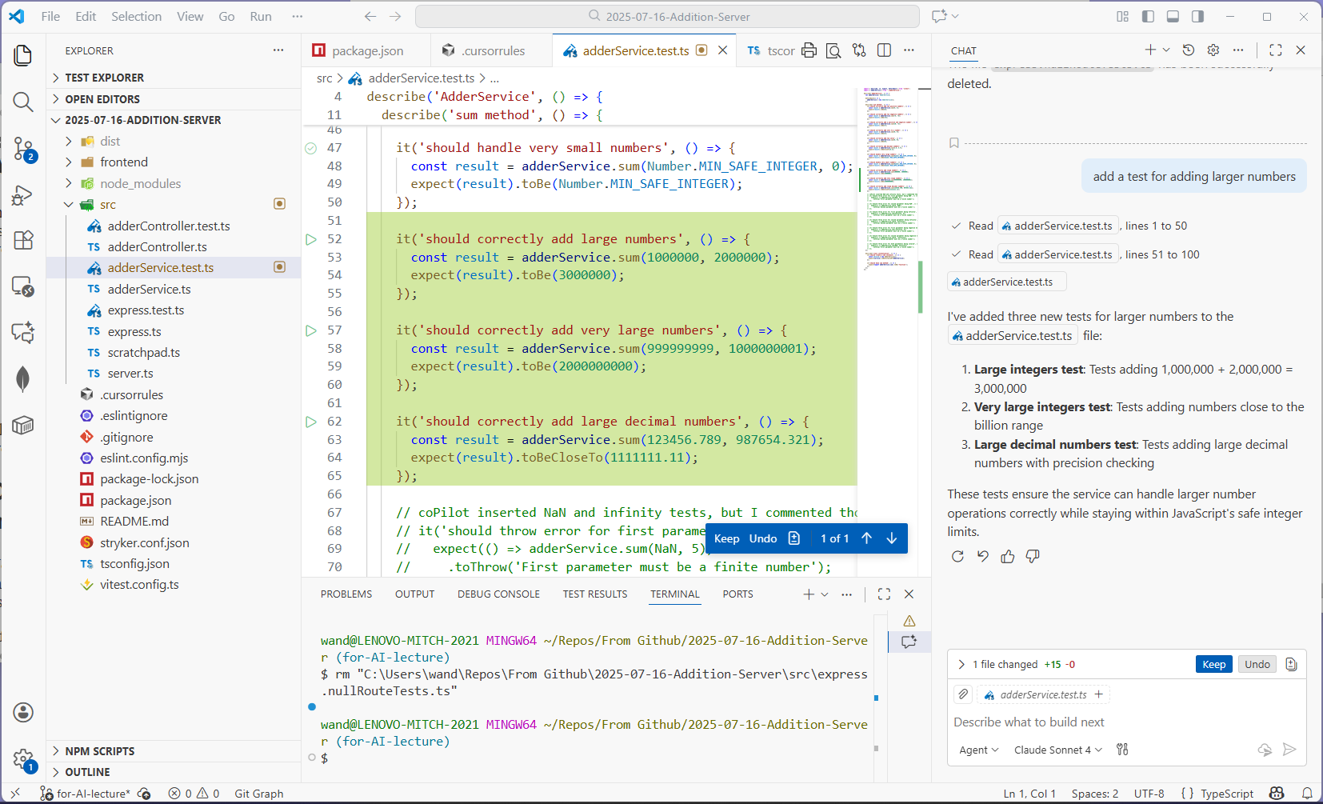
Watching the AI work
Notes:
Here I am making an edit through my AI. Let's look at this interaction in detail.

Slide 28
The Request
Notes:
Let's look at the pieces. <click> On the right-hand side is the interaction pane. Down at the bottom <click> you'll observe that the context specifies the file or files on I'm working on. Here it's adderserverice.test.ts . At the top <click>, you'll see what I asked for. And then in the middle<click>, you'll see what the AI said about what it did.

Slide 29
Notes:
And here's what it did. You'll see the new code in green. Any code that was deleted will be in red. Below, there's a box to give me the option to keep the change or undo it. And off to the left, in the explorer pane, you'll see a little square marking the modified files. Often, a change will affect many files, so it's important to keep track of which files were modified, and to accept or reject the changes promptly!

Slide 30
The final steps: Calibrate/Tweak/Finalize
Calibrate: Steer AI toward desired outcomes through feedback
Tweak: Refine AI-generated artifacts based on standards
Finalize: Document decisions and rationale
Notes:
Don't forget "finalize" -- you'll need to document what you've done so the next person (or the next AI) will know what's happening. Remember what we said way back in Module 4:

Slide 31
Use Design As a Way of Communicating Organization
Remember this from Module 04 Code Level Design?
Software systems must be comprehensible by humans
Which humans?
The other members of your team
The folks who will maintain and modify your system
Management
Your clients
and ...
You, a week from now or 6 weeks from now
Notes:
To put this in context, Design is the SE activity before coding. There is a saying in SE that goes like this: “Design is not coding, coding is not design”. Design is a critical part of your SE process.
<Read slide>

Slide 32
What can't an AI do (or do well)
Architecture/Design
if you tell it the architecture, the AI can build it
but the AI can't decide on the design
Debugging (!!!!)
Ais are trained on working code, so their debugging skills are often not very good (but this may change).
Maintenance
I don't think we have much info on this yet

Slide 33
Task familiarity determines appropriateness
Use AI when: You have sufficient domain knowledge to evaluate outputs
Avoid AI when: You lack the expertise to assess correctness and quality
Learning consideration: Using AI without foundational knowledge can lead to deskilling

Slide 34
Beware of De-Skilling
Adopt a “learning tax” strategy: deliberately choose to implement certain components manually, even when AI could generate them instantly.
Otherwise you won't recognize when the AI is screwing up!
The goal isn’t to code without AI or to use it for everything, but to maintain the expertise that makes you irreplaceable—the judgment, creativity, and deep understanding that transforms good code into great software. (--Jon Bell)

Slide 35
Remember:
Learning Comes Only Through Struggle
https://www.dreamstime.com/illustration/inner-struggle.html

Slide 36
In other fields, de-skilling is harder to avoid
AI is rapidly replacing
customer-service agents
first-year stock traders on Wall Street
???
Notes:
AI-powered customer-service agents are getting very good. People have measured that caller satisfaction has actually gone UP. (I've experienced this myself).

Slide 37
Implications: What skills will the future software engineer need?
Design: ++
Coding: --
Debugging: +++
Requirements Acquisition: +++
Human Factors/Teamwork: ++
Notes:
These are just my guesses. Come back in 2 years and see how it works out.

Slide 38
Review: Learning Goals for this Lesson
You should now be able to:
Explain what an AI Coding Agent is and is not
Describe when using an AI agent is or is not appropriate
Explain a good pattern for using an AI coding agent
Understand the basics of good prompting
Know how to supervise an AI coding agent at work
Know how to avoid de-skilling
Notes:
<read slide>

